Slide 1
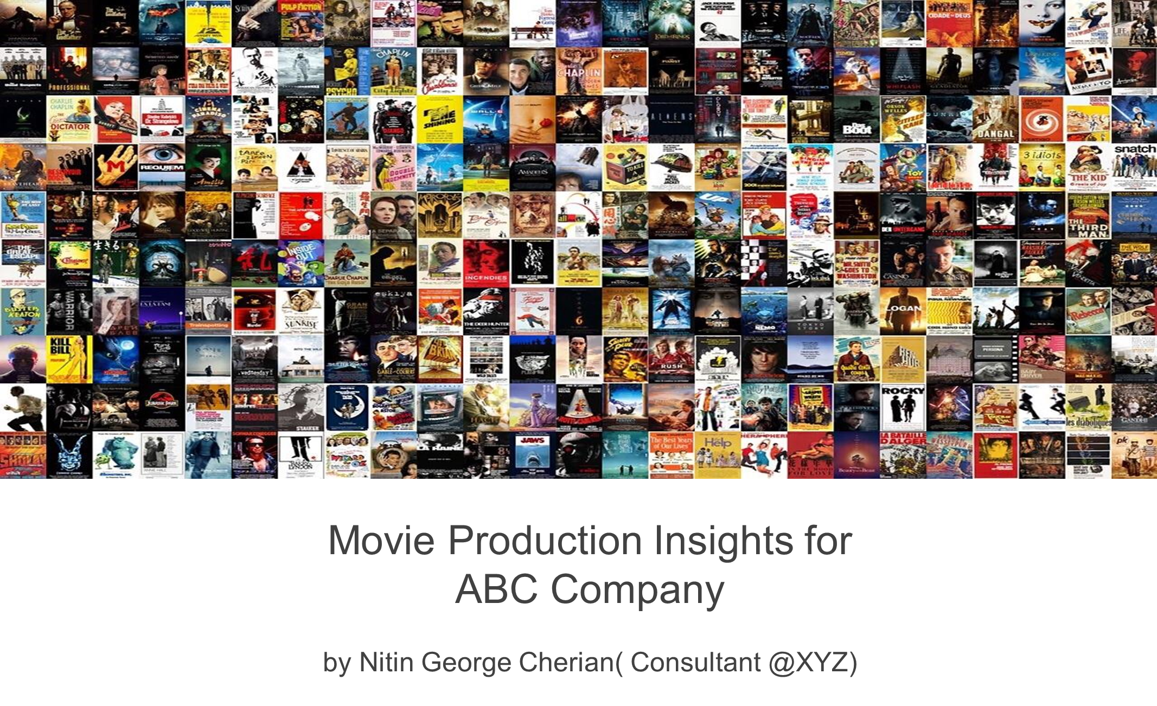

Slide 2
Problem Statement
ABC Movie Production Company approaches XYZ agency in the beginning of year 2017
ABC’s Aim: Produce Movies that earn highest Revenue, Rating and Critical Acclaim.
ABC’s Need: Find out characteristics of movies that earn highest Revenue, Rating and Critical Acclaim
ABC also wants to know:
Movie Industry Growth ?
Right time to invest in the Movie Industry ?

Slide 3
BACKGROUND
IMDB (Internet Movie Database): Popular online database for movies, television programs etc.
IMDB Registered users: Rate movies on a scale of 1 to 10.
IMDB Rating: Weighted-Mean Rating displayed beside each movie title.
Metascore: IMDB also displays rating from metacritic.com
IMDB Most Popular 1000 movies from 2006-2016 would be ideal to find insights for ABC’s need.

Slide 4
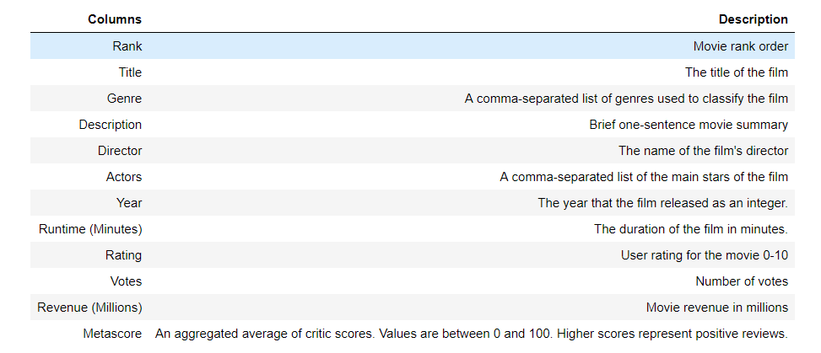
DATA IN DEPTH
The data dictionary describing the different columns in the dataset.

Slide 5
DATA IN DEPT (…)
Consists of 1000 rows (movies) and 12 columns (Rank, Title, Rating etc)
% missing values in columns: Revenue - 13% (High) , Metascore - (6%)
Filled missing values in columns:
Revenue – by Median Revenue
Metascore – Dropped rows with missing values.
After cleaning: 936 rows and 12 columns
There is no incorrect datatypes.
The relationship of Genre, Director, Runtime of movies against Revenue, Rating and Metascore could provide significant insights.

Slide 6
WHAT DID I DO ?
Examined the dataset
Cleaned up the dataset
Came up with several questions to find out the relationship of Genre, Director and Runtime of movies against Revenue, Rating and Metascore.
Explored the dataset based on the questions using descriptive statistics and visualization.
Drew conclusions from the exploration.
Found out actionable insights from conclusion.

Slide 7
WHAT DID I DO ? (…)
Explored the impact of Director on a movie’s Revenue, Rating and Metascore.
Classified the Runtime of a movie into 4 categories: Short, Medium, Moderately Long and Long
Analyzed movie’s Revenue, Rating and Metascore against these categories.
Explored the effect of Genre count on a movie’s Revenue, Rating and Metascore.
Explored the effect of Genre combination on a movie’s Revenue, Rating and Metascore.
Analyzed the growth of movie industry over the 10 year period in terms of Revenue and Rating.
Explored the correlation between Revenue, Rating and Metascore.

Slide 8
EXPLORATION AND CONCLUSION

Slide 9
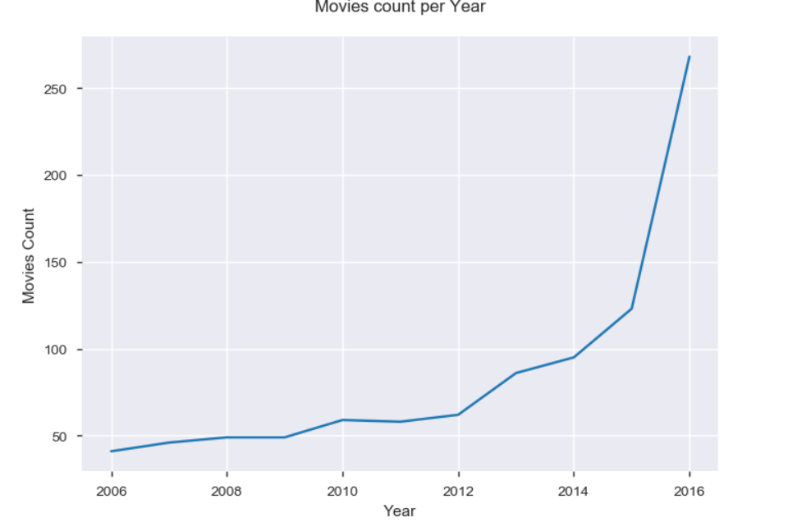
INDUSTRY GROWTH Y-ON-Y V/s MOVIE COUNT
Growing with respect to number of movies released.

Slide 10
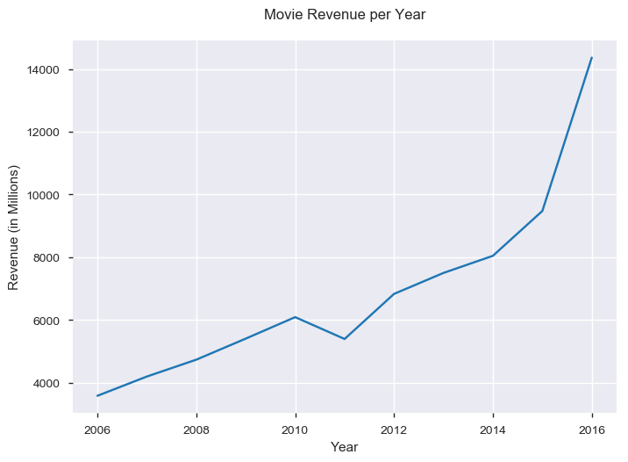
INDUSTRY GROWTH Y-ON-Y V/s TOTAL REVENUE
Growing in terms of Total Revenue per year

Slide 11
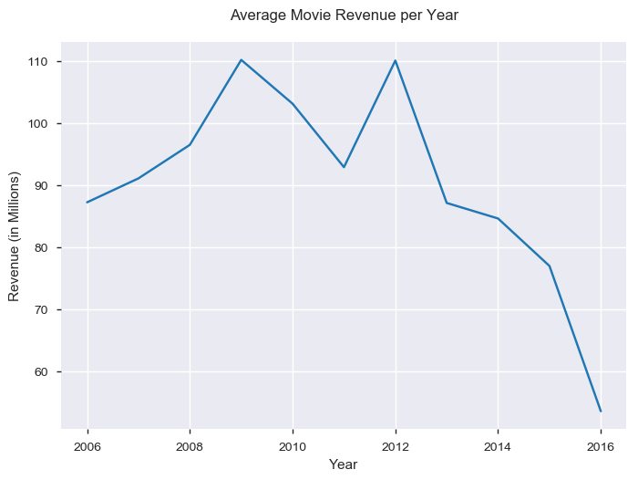
INDUSTRY GROWTH Y-ON-Y V/S AVERAGE REVENUE
Decreasing Trend.
Competition is increasing and more movies are released per year
Total revenue gets distributed among many movies.

Slide 12
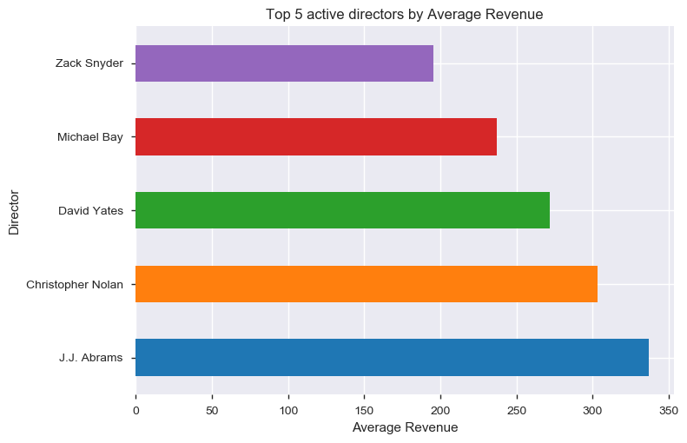
ACTIVE DIRECTOR V/s REVENUE
The top 5 active directors in terms of average revenue
J.J Abrams tops the chart.
Closely followed by Christopher Nolan.

Slide 13
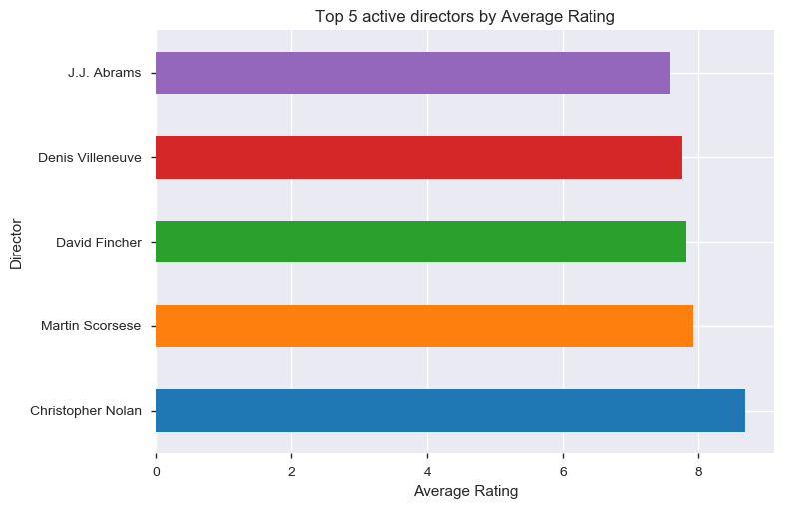
ACTIVE DIRECTOR V/s Rating
The top 5 active directors in terms of average rating
Christopher Nolan tops the list

Slide 14
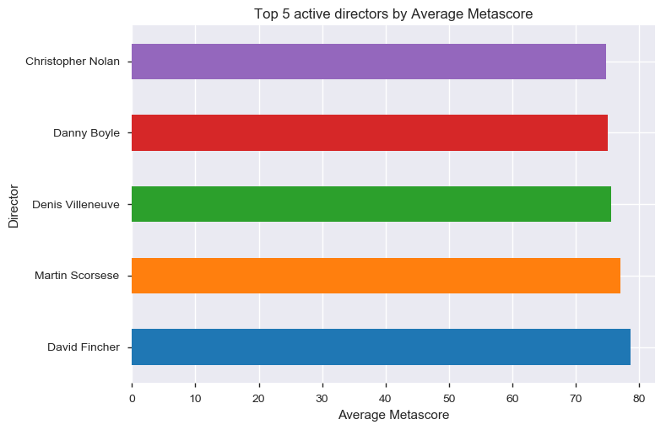
ACTIVE DIRECTOR V/s METASCORE
The top 5 active directors in terms of average metascore
David Fincher tops the list
Christopher Nolan also features

Slide 15
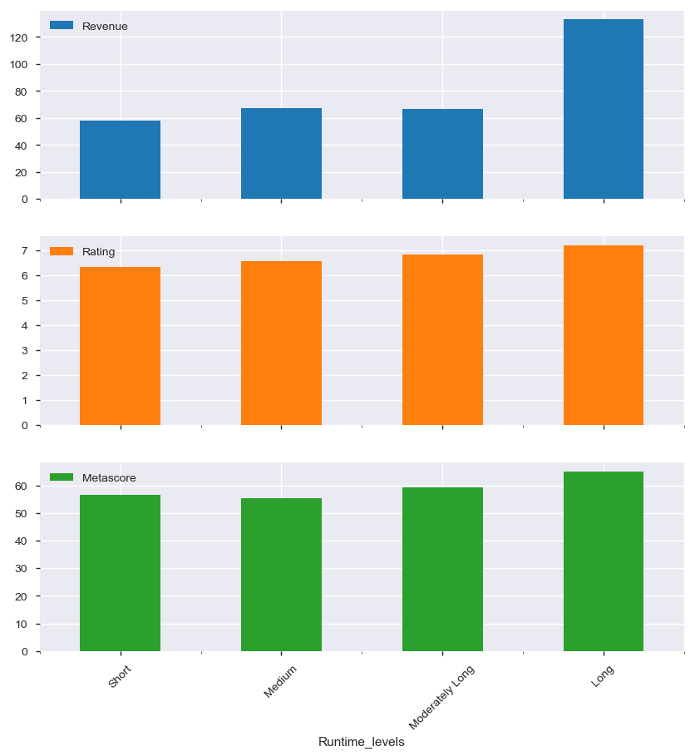
IMPACT OF MOVIE RUNTIME
Movies with ‘Long’ Runtimes (>123 minutes) earn more in terms of Revenue, Rating and Metascore
Revenue dramatically high for movies with Long Runtime.

Slide 16
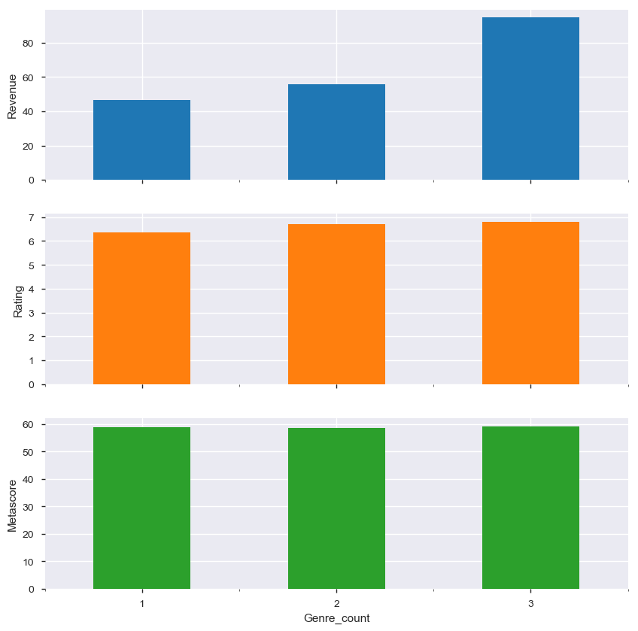
IMPACT OF GENRE COUNT
Movie’s Revenue, Rating and Metascore increases as the Genre count increases.
Genre count = 3 → Revenue significantly High

Slide 17
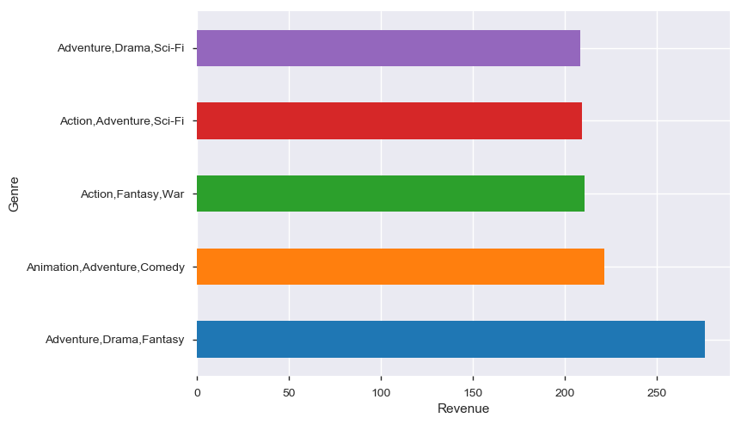
GENRE COMBINATION vs REVENUE
‘Adventure, Drama, Fantasy’ – earn highest average revenue
Adventure features more in the top 5

Slide 18
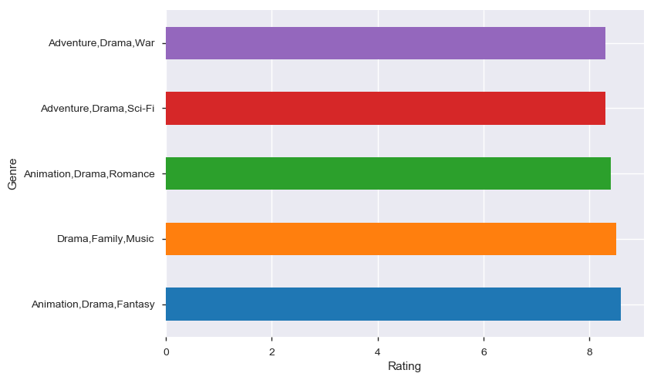
GENRE COMBINATION VS RATING
‘Animation, Drama, Fantasy’ – earn highest average rating
Drama is the most popular

Slide 19
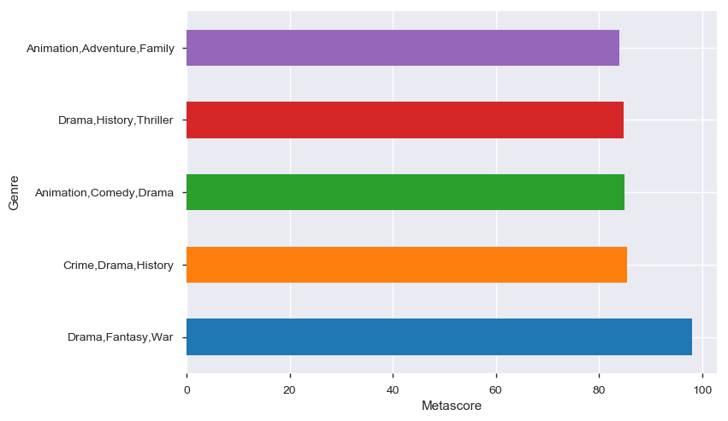
GENRE COMBINATION VS METASCORE
“Drama, Fantasy, War"– earn highest average metascore
Drama is the most popular among critics

Slide 20
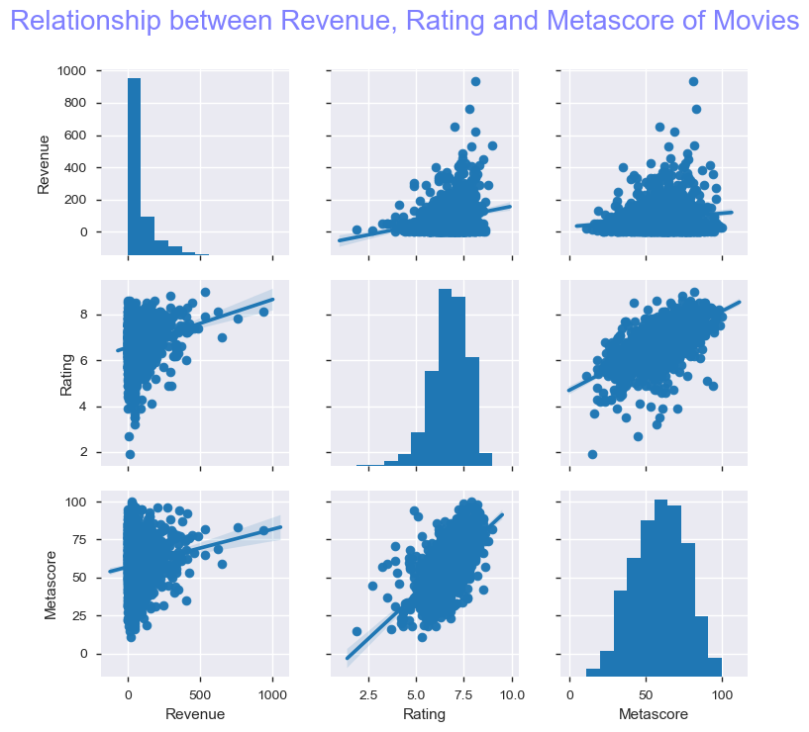
CORRELATION: REVENUE, RATING AND METASCORE
Rating and Metascore have strong correlation.
As the Rating increases, the Revenue also tend to increase
As the Metascore increases, the Revenue also tend to increase.
The IMDB users and Critics tend to agree with each other.

Slide 21
ACTIONABLE INSIGHTS

Slide 22
WHAT SHOULD ABC COMPANY DO ?
Produce multiple movies with best features - The movie industry is growing very fast. More movies are released year on year and the competition is very high and the revenue is distributed among many movies. It would not be a good idea to wait for that ONE BIG MOVIE like Avatar (by James Cameron) that brings highest Revenue, Rating and Metascore. So, produce more movies using the best features (explained below) for reaping the maximum benefits.
Produce movies with active directors - those people who directs multiple moderately high budget movies. For instance, Christopher Nolan movies is certain to bring in more Revenue, Rating and Metascore.
Produce movies that have Long runtimes - Runtime greater than 2 hrs.
Produce movies with 3 Genre combination - Include a mix of Drama, Animation, Adventure, Sci-Fi, Fantasy. The movies should relate to audience with real life incidents, should move them to the edge of the seats and should enhance their imagination.
Produce movies that will satisfy both People and Critics - These movies will earn higher Revenue more often than not.

Slide 23
THANKS
nitin.cherian@gmail.com

